Slide 1

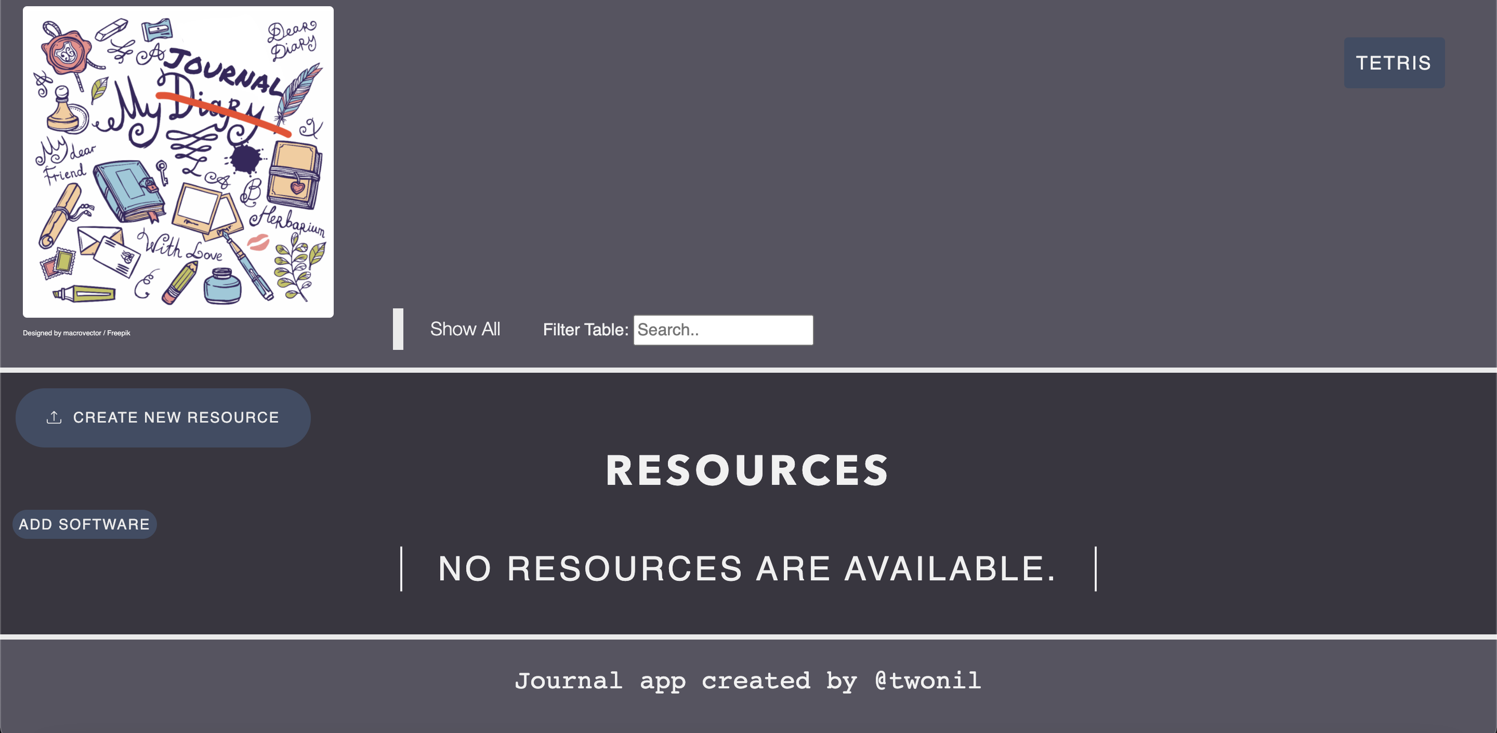
My Journal

Slide 2
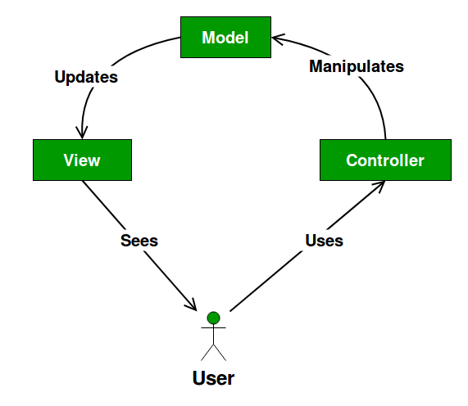
Intro
MVP:
A web journal app for storing and accessing resources, via links.
Design:
Using an MVC pattern.
Reason for building this:
To be able to easily find and access any resources I may come across in future, as well as getting to grips with frontend and backend technology, and getting a deeper understanding behind code which will help me with future QA work.

Slide 3
User Stories
As an admin, I want to add a resource via admin portal, so that it updates on the front-end for the user.
As a user, I want to delete a resource, so that it isn’t in the way.
As a user, I want to search the resource list, so that I can easily find resources.
As a user, I want to filter the software tags, so that I can find resources specific to the software I am using.
As a user, I want to create a resource, so that I can use it in the future.
As a user, I want to edit a resource, so that I can rectify mistakes.

Slide 4
Demo
My journal app

Slide 5
Home Page Test scenarios
**As a user, I want to search the resource list, so that I can easily find resources.
****As a user, I want to filter the software tags, so that I can find resources specific to the software I am using.
Given I am on the home page: when I click ‘create new resource’ button, I am redirected to create new resource page.
when I click ‘add software’ button, I am redirected to add software page.
when I click ‘tetris’ button, I am redirected to tetris page.
when I scroll to bottom of page, footer reads “Journal app created by Nilay Patel” and “Journal app created by @twonil” at some point.
Given I have resources in the table: **when I use the search bar, the table is filtered to that search.
****when I click a software filter, the table is filtered to those software tags.
when I click a software tag, the table is filtered to those software tags.
when I click a link, I am redirected to the link.
when I click an attachment, the attachment is loaded.
when I click delete button, the page redirects to confirmation page.
when I click edit button, the page redirects to edit resource page.
Given I have no resources in the table: when I look at the page, I get “No resources are available” message.
Given I have added a new software: when I look at the page, I see the new software on the filter tabs.
Given I have deleted a resource: ***when I look at the table, the selected resource is not present.
Given I have created a resource: ***when I look at the table, the new resource is present.
Given I have updated a resource: ***when I look at the table, the existing resource is updated.

Slide 6
Add/Edit Resource Page Test scenarios
**As a user, I want to create a resource, so that I can use it in the future.
****As a user, I want to edit a resource, so that I can rectify mistakes.
Given I am on the add resource page: when I click logo, I am redirected to home page.
when I click ‘Tetris’ button, I am redirected to Tetris page.
when I click create without name, I am told to fill out Name field.
when I click create with an invalid URL in link, I’m told to enter a URL.
when I click choose a file to upload, I’m told the file name to confirm it’s the right one.
when I click cancel, I’m redirected to home page with no new resource added.
**when I click create, I’m redirected to home page with the new resource added.
Given I am on the edit resource page: when I click logo, I am redirected to home page.
when I click ‘Tetris’ button, I am redirected to Tetris page.
when I look at the form, I see it is filled out with corresponding resource information.
when I click update without name, I am told to fill out Name field.
when I click update form with invalid URL in link, I’m told to enter a URL.
when I click choose a file to upload, I’m told the file name to confirm it’s the right one.
when I click cancel, I’m redirected to home page with no new resource added.
***when I click update, I’m redirected to home page with the existing resource updated.
Given I have added a new software: when I click create new resource, I’m able to use the new software tag.
when I click edit resource, I’m able to use the new software tag.

Slide 7
Delete Resource/Add Software Page Test scenarios
**As a user, I want to delete a resource, so that it isn’t in the way.
Given I am on the delete resource page: when I click logo, I am redirected to home page.
when I click ‘Tetris’ button, I am redirected to Tetris page.
when I look at the page, I see “Are you sure you want to delete this resource?”.
when I look at the page, I see the corresponding resource information.
when I click cancel, I’m redirected to home page with the existing resource still there.
**when I click confirm, I’m redirected to home page.
Given I am on the add software page: when I click logo, I am redirected to home page.
when I click ‘Tetris’ button, I am redirected to Tetris page.
when I click submit without a software tag, I am told to fill out field.
when I click cancel, I’m redirected to home page with no new software added.
when I click submit, I’m redirected to home page.
when I click submit with an existing software tag, I’m not redirected and software isn’t duplicated.

Slide 8
Admin Page Test scenarios
**As an admin, I want to add a resource via admin portal, so that it updates on the front-end for the user.
Given I have created a resource through admin portal: **when user views home page, they can see newly added resource.
Given I have edited a resource through admin portal: when user views home page, they can see newly updated resource.
Given I have deleted a resource through admin portal: when user views home page, they can’t see old resource.
Given I have added a software through admin portal: when user views home page, they can see new software filter.
when user creates resource, they can use new software tag.
when user updates resource, they can use new software tag.
when user adds software, they can’t use new software tag.

Slide 9
Future Improvements
Make the home page phone compatible.
Make home page more responsive to window size change.
Add a nav bar.
Create account feature so individuals can have access to their own private resource list.
Error messages when software tag already exists.

Slide 10
Blank
Blank

Slide 11
Blank
Blank

